Slide 1

INDO TAIWAN TRADE

Slide 2
PREAMBLE OVER VIEW
COMPLIANCES
HOW CAN U BE IN INDIA
HOW TO SET UP BUSINESS IN INDIA
HAND HOLDING BY MVC
INVESTMENT VEHICLE ?
INCENTIVES, FDI,FTA,DTAA,TAXATION
PREAMBLE/ OVER VIEW
LIASION OFFICE/BRANCH/WHOLLY OWNED SUBSIDIARY………..A COMPARISON
FAQ
CURRENT TRADE

Slide 3
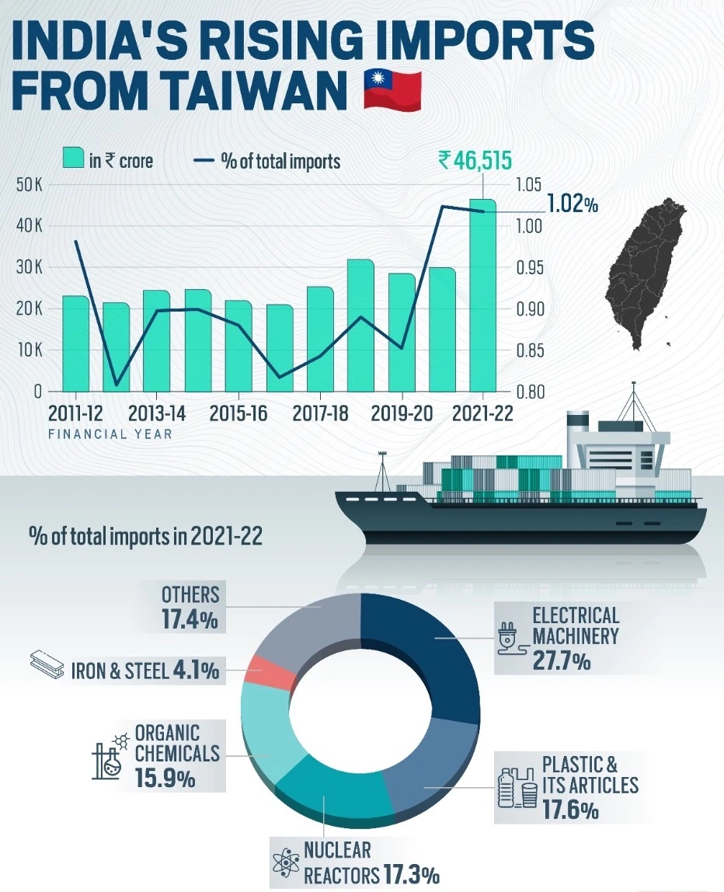
THE RISING TREND

Slide 4
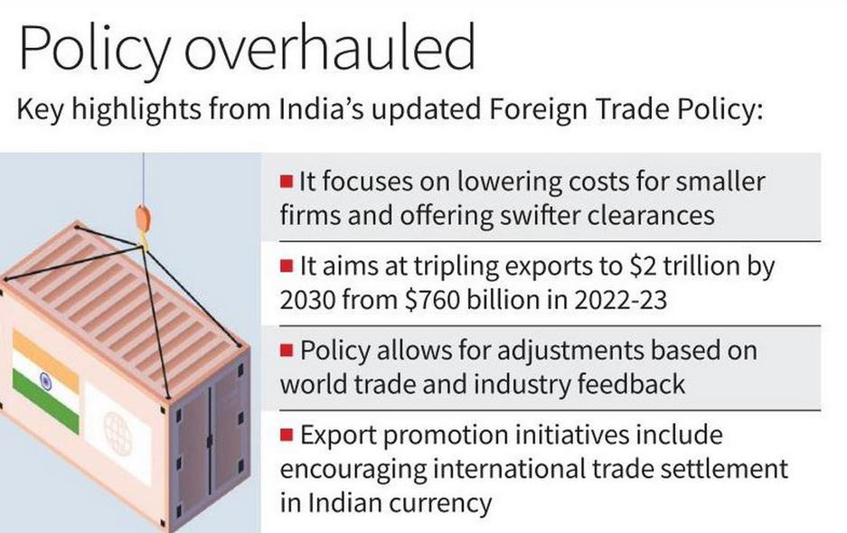
INDIAN TRADE POLICY

Slide 5
FDI
Top 5 sectors receiving highest FDI Equity Inflow during FY 2022-23 are Services Sector, Computers, Trading, Communications & Automobiles
CATEGORY 1:100%,FDI Permitted through, Automatic Route
CATEGORY 2:UPTO100%,FDI Permitted through, Government Route
CATEGORY 3:UPTO100%,FDI Permitted through, Government + Automatic Route
Automatic Route:Under the Automatic Route, the non-resident investor or the Indian company does not require any approval from Government of India for the investment
Government Route:Under the Government Route, prior to investment, approval from the Government of India is required.

Slide 6
FTA
FTA
While a Free Trade Agreement remains the gold standard for trading relationships Taiwan aspires, the possibility of an India-Taiwan FTA is not on the card. Its absence does not mean trade relations and opportunities cannot be advanced, suggests a former foreign secretary.
SUPPLY CHAIN
As a vibrant democracy, a top producer of the most advanced microchips and the 21st largest economy in the world, Taiwan has strived to bolster supply chain resilience with India and other partner countries
BILATERAL TRADE
While Taiwan-India bilateral trade reached an all-time high of US$7.7 billion in 2021, that figure only accounts for a fraction of the respective annual foreign trade — only 0.9% in Taiwan’s external trade & 0.8% of India’s.
SEMI
CONDCUTIOR
GOVT.
SCHEMES
ATMP
Taiwan’s main strength is in the machinery and electrical equipment sector which thrives on its semiconductor manufacturing capabilities. The importance of semiconductors can be gauged from the fact that it is the most critical material– brains of modern electronics — driving technologies for national economic growth, security, and global competitiveness.
Various schemes launched by the Government of India, for the semiconductor industry, such as the Design Linked Incentive (DLI) and Production Linked Incentive (PLI) schemes.
The scheme now provides uniform 50% fiscal support for all nodes (65nm to 28nm chip production). Besides, it will provide 50% of capital expenditure in the process which includes chip design, assembly, testing, marking and packaging (ATMP).

Slide 7
TAX INCENTIVES
REPATRIATION OF FUNDS BY FOREIGN COMPANY & INDIVUDUALS RESIDENT IN TAIWAN
TAX SLAB RATES (1) NEW MFG 15% (2) WITHOUT DEDUCTIONS 22% (3) WITH DEDUCTIONS 25%
TAX INCENTIVE FOR CAPITAL EXPENDITURE FOR SPECIFIED BUSINESS
INCENTIVES FOR SEZ
PLI,REMISSION OF DUTIES,CUSTOM DUTY CHANGES
NON TAX BENEFITS FOR MSME
START UPS CAN CARRY FORWARD LOSSES FOR 10 YEARS, NO TAX FOR FIRST THREE YEARS
FACELESS CUSTOM,TAXATION

Slide 8
WHY INVEST IN INDIA
INDIA
FTA
FDI
DOMESTIC CONSUMPTION IN ELECTRONICS
INDUSTRY
SEMI CONDUCTORCLUSTERS
MSME
SUPPLY
LOGISTIC CHAIN
SKILL
TECH
INFRA

Slide 9
INVESTMENT VEHICLE ?
DECISION
LIASION
PERMANENT
INVEST
FUNDED
EQUITY
FOREIGN
WOS
JV
BRANCH
JV
COMPANY
DUE
DILIGENCE
COMMON
BIZ GOAL
LAWS
REGULATION
SIZE
OPERATIONS
EXIT
STRATEGY
DEBENTURES
CONVERTIBLE
PI
ECB
LIASON
NO BIZ
PROJECT
SPECIFIC
BRANCH
SAME BIZ
AGENCY
TRADE
SERVICE
COLLOBORATE
CONSULTATION
WHOLLY OWNED
BIZ OF
PARENT
FUNDED
FDI
CONVENIENT
BENEFICIAL
LOW
RISK
DUE
DILIGENCE
PARTNERS
MARKET
PARTNERS
INFRA
DISTRIBUTION
MANAGEMENT
CO
PVT
LTD
LLP
FOREIGN
DIRECTOR
SEC
8
JV
EASE OF
ESTABLISHING

Slide 10
HOW CAN U BE IN INDIA
PE
PERMANET
ESTABLISHEMENT
FOREIGN
REPRESENTATIVE
OFFICE
COMPANY
FOREIGN
INDIAN
TECH
PARTNER
SERVICES
GOODS
MANUFACTURING
COMPANY
JV
SHARE
HOLDER
OPC
LLP
PVT
SEC 8
ONE INDIAN & FOREIGNER DIRECTOR
LLP
WHOLLY OWNED SUBSIDIARY
BRANCH
TEMPORARY
PRESENCE
NET WORTH MIN USD 100,000
LAST 5 YEARS PROFIT MAKING COMPANY
RBI
APPROVAL

Slide 11
COMPANY INCORPORATION
REGISTER
TRADE MARK SEARCH
21 DAYS
TAX
PAN
TAN
BANK
ROC,PAN,DIN
MOA,AOA
COMPLIANCE
NAME APPROVAL
MOA
AOA
DIN
RENT AGREEMENT
ROC
GST
AUTH SIGNATORY
ONLINE PROCESS
ON LINE PROCESS
PERSONAL VISIT
ONLINE BANKING
15 DAYS
7 DAYS
DIRECTORS( MIN 2)
DIGITAL SIGNATURE
REGULATOR
GST
TDS
ROC
30 DAYS
TRADE
DIC
FDI
FEMA
CUSTOM
21 DAYS
LABOUR
CONTRACT
POLLUTION
FIRE
ON LINE PROCESS
ON LINE
INDUSTRY
FACTORY
IEC
RBI
ON LINE
ONE INDIAN DIRECTOR
DIRECTORS AND SHAREHOLDERS SAME
NO MINIMUM AUTHORIZED CAPITAL
ROC
MINIMUM 4 BOM MEETINGS
MGT-7
AOC-4
DIR 3 KYC
AGM CONDUCT
ON LINE
PROFF TAX

Slide 12
RESIDENCE & TAXATION
RESIDENT
STAY IN INDIA
INCOME EARNED
POEM
PE
RO
TP
INCENTIVES
DEDUCTION
TAXATION
DIEM
MANAGEMENT
DECISION
MAKING
ROYALTY
INVOICING
SERVICES
RELATED
PARTIES
ARMS
LENGTH
SEZ
STATE
INDUSTRY
SECTOR
TAX
DEPRECIATION
ACCLERATED
INVESTMENT
PRE INCOPORATION
15%
NIL DEDUCTION
25%
DEDUCTION
DEFERRED
TAX ASSET
MAT
INDIVIDUAL
SALARY
PERQUISITES
DTAA

Slide 13
TAXATION
RULE FOR RESIDENCE IN INDIA 182 DAYS
PLACE OF EFFECTIVE MANAGEMENT
TRANSFER PRICING
TAXATION OF FOREIGN COMPANIES
TAXATION OF CORPORATES
PAN ……TAX IDENTIFICATION NUMBER
PERMANENT ESTABLISHMENT
WITHHOLDING TAX & DTAA

Slide 14
COMPANY COMPLIANCE:ON LINE
TDS & ADVANCE TAX
PAYROLL,LABOUR & EPF
ROC
FACTORY & POLLUTION
ANNUAL RETURNS
TAX AUDIT
PURCHASE & SALES GST
ACCOUNTING STANDARDS : Ind AS/ IFRS

Slide 15
ANALYSIS OF BUSINESS TYPES
LIASION
ONLY LIASION
NO BUSINESS
NO LEGAL
STANDING
BRANCH
ACTIVITY OF
PARENT CO
NO LEGAL
STANDING
WHOLLY OWNED SUBSIDIARY
REPRESENTATION &
PROMOTION
PARENT CO
PROFITABLE
LAST 3 YEARS
NO COMMERCIAL ACTIVITY
IMPORT, EXPORT,
TECHNICAL SERVICES,
COLLOBORATIONS, RESERACH
PARENT CO
PROFITABLE
LAST 5 YEARS
NO EXPANSION
NO RETAIL BIZ
OF ACTIVITY UNLESS
RBI APPROVED
JV
INCORPORATED
ENTITY
SEPARATE ENTITY
AS PER OBJECTS,
COMMUNICATION CHANNEL
MINIMUN
SHARE CAP ITAL
IND RS 1.00 LACS
ACTIVITY AS PER OBJECTIVE
AGREEMENT WITH DOMESTIC CO
SEPARATE ENTITY
INDIAN PARTNER
AS PER BUSINESS
AGREEMENT,
AGENCY,
SERVICES,
MINIMUM
SHARE CAPITAL
IND RS 1.00 LACS
AS PER
AGENCY AGREEMENT
FUNDED BY
PARENT CO
NO TAX
COMMISSION, INCOME REPATRIABLE
AFTER TAX
INCOME REPATRAIBLE
AFTER TAX
AGENCY FEES
REPATRAIBALE
AFTER TAX

Slide 16
FAQs
TIME TO REGISTER BUSINESS / CO IN INDIA
CAN FOREIGN CO REGISTER IN INDIA
VAILIDTY OF INCORPORATION
IEC,DIN,PAN,TAN,DIGITAL SIGNATURE
CAN NRI BE DIRECTOR OF COMPANY
MINIMUM STATUTORY COMPLIANCE
REGULATIONS FOR FOREIGN CO TO ESTABLISH BUSINESS IN INDIA
CAN FOREIGN COMPANY REPATRIATE PROFITS
HOW DIFFERENT IS INCORPORATION, VAT, INCOME TAX, ACCOUNTING,BANKING COMPARED TO TAIWAN
TRADE MARK, COPYRIGHT,IP RIGHTS,LICENCES
PLACE OF EFFECTIVE MANAGEMENT
TRANSFER PRICING

Slide 17
MVC CONSULTANCY & SERVICES
SELECTING MODE OF INVESTMENT
COMPANY REGISTRATION
TRADE MARK REGISTRATION
COMPLIANCES
TAXATION
PAYROLL MANAGEMENT
ACCOUNTING
INTERNAL AUDIT
CERTIFICATIONS
FILINGS,RENEWALS
STATUTORY AUDIT
LEGAL REPRESENTATION

